Slide 1
Radiofrequency Pulses in MRI
Lecture 1
Mahesh Keerthivasan
BME 639
University of Arizona

Slide 2
RF Excitation
Main
Field
Bo
z
North
z
B1(t)
B1
M₀
y
y
Applied B1 RF Field
x
M₀
x
The RF pulse rotates Mo the about applied field
Adapted from Larry Wald’s slides, fMRI MR Physics

Slide 3
The B1 Field
B1 field: a time varying radio frequency field at Larmor frequency and perpendicular to B₀
Alternating current at Larmor frequency
B₀
Birdcage RF Coil
B1 field
http://mriquestions.com/

Slide 4
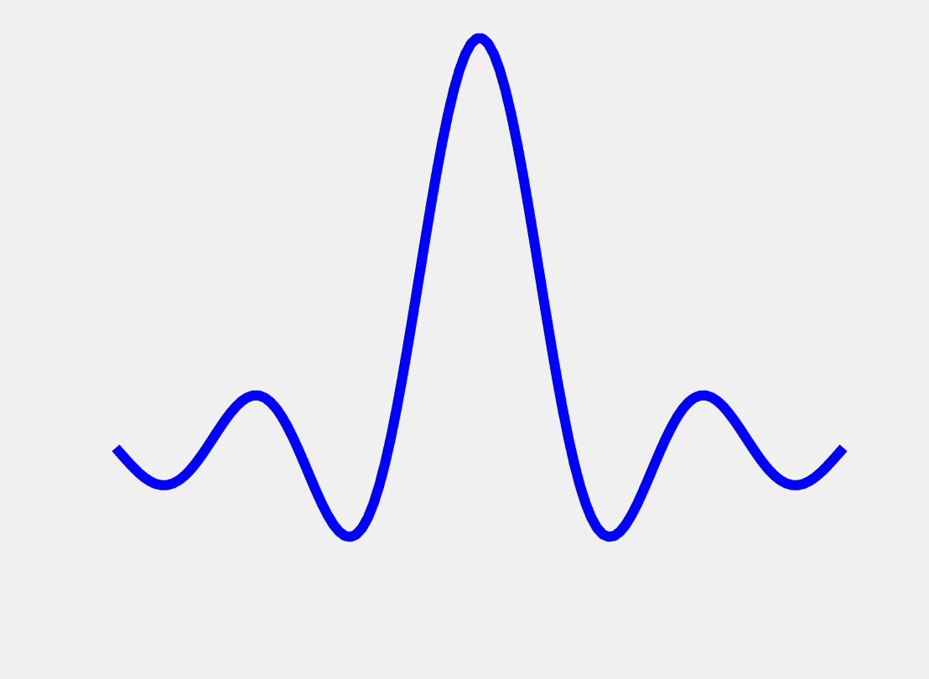
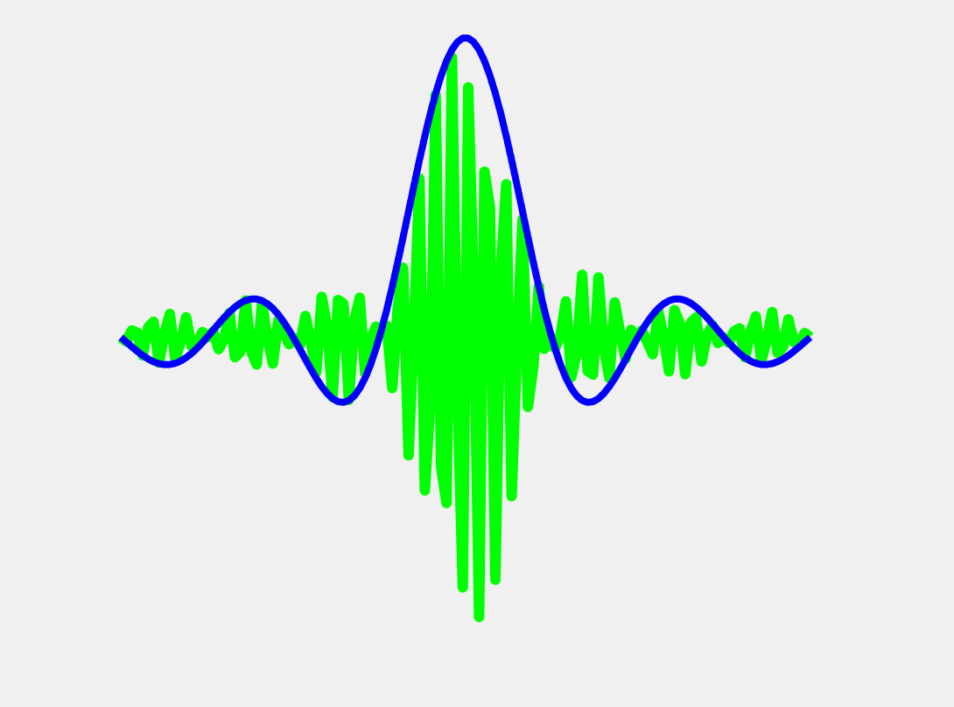
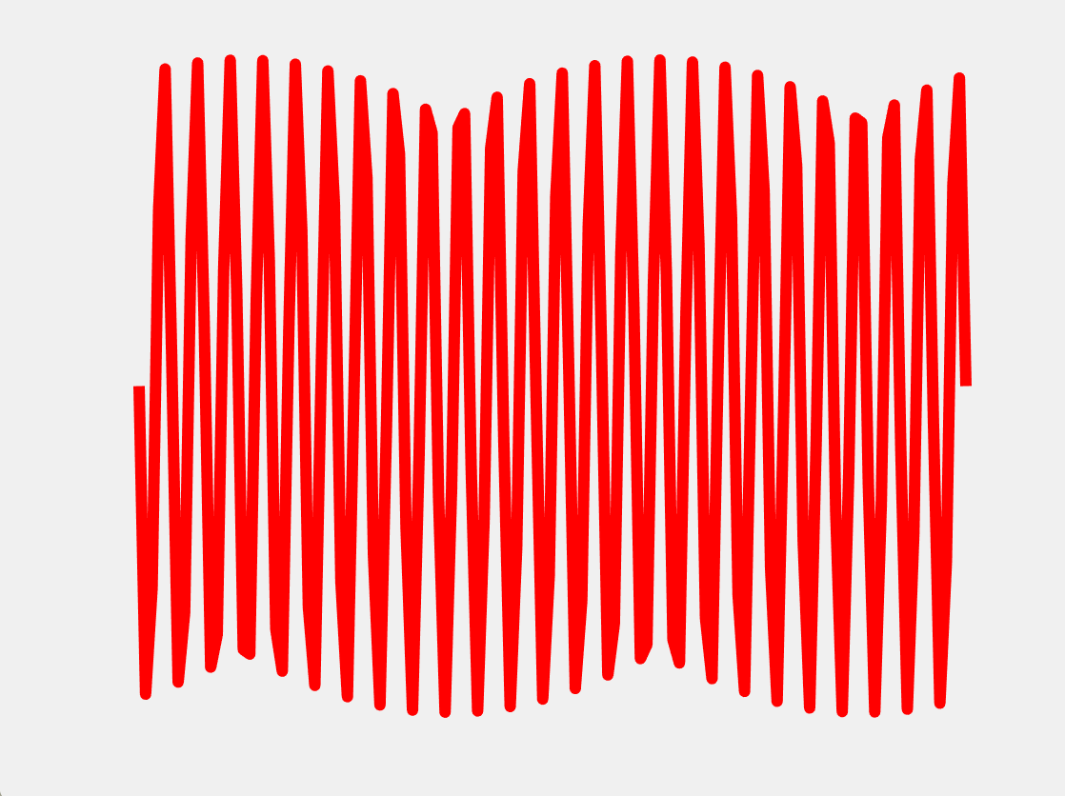
The B1 Field
B1 field generation:
Frequency synthesizer
(generate carrier wave at Larmor frequency)
Pulse Modulator
(use short RF pulses to modulate the carrier wave)
Power Amplifier
(control peak B1 field amplitude and flip angle)
RF Envelope B1(t)
Transmit Coil
(quadrature or circularly polarized to generate field)
Sinusoidal carrier wave at
Larmor frequency >~48MHz
Carrier frequency modulated by a low frequency sinc RF ~kHz
http://mriquestions.com/

Slide 5
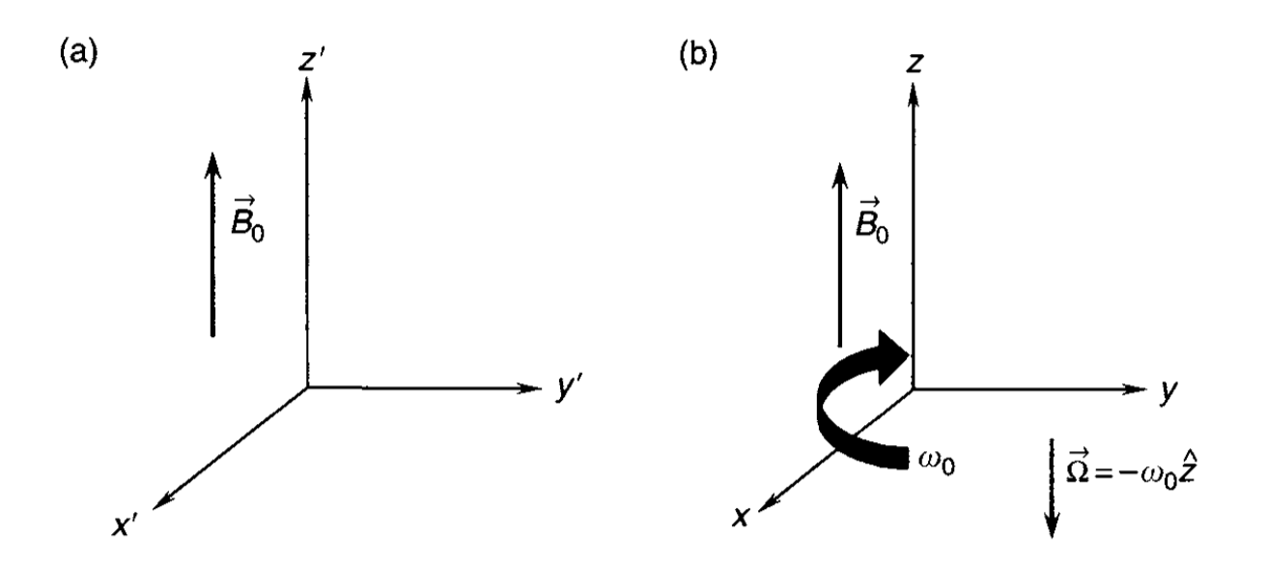

The B1 Field
A circularly polarized B1 field at carrier frequency is represented in the laboratory frame:
$$\vec{B1}\left(t\right)=x^{′}B1\left(t\right)\cos\left(ω_{c}t\right)−y^{′}B1\left(t\right) sin⁡(ω_{c}t)$$
Transforming to the rotating frame and using $ω_{c}$ as the angular rotating frequency $ω_{0}$:
$\left[\begin{aligned}B1_{x}(t) \\ B1_{y}(t) \\ B1_{z}(t)\end{aligned}\right]$ = $\left[\begin{aligned}B1(t) \\ 0 \\ 0\end{aligned}\right]$
The rotating frame demodulates the RF oscillations
into the envelope $B1(t)$
Laboratory frame
Rotating frame
Handbook of MRI Pulse Sequences, Bernstein
http://mriquestions.com

Slide 6

Motivation
We would like to understand:
Properties of the RF pulse
Effect of RF on magnetization
Design efficient RF pulses
time $(μs)$

Slide 7
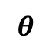

Flip Angle
Magnetization is tipped out of equilibrium due to applied B1 field
z
Bo
B1
Flip angle when RF frequency matches Larmor frequency:
$$θ=γ\int_{t^{′}=0}^{T}{B1\left(t^{′}\right)dt′}$$
Flip angle is the area under envelope of RF field
$$θ$$
y
M₀
x

Slide 8
Flip Angle
Flip angle = 30º
Flip angle = 45º
Flip angle = 90º

Slide 9
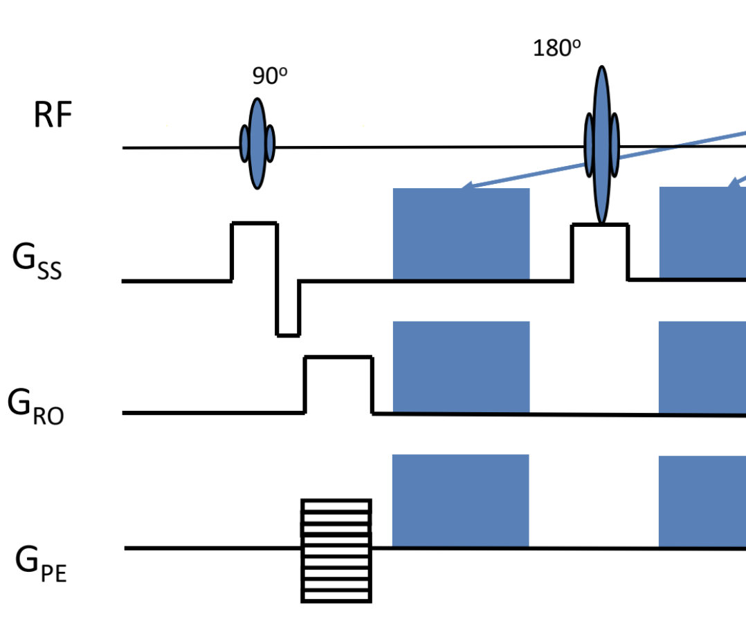
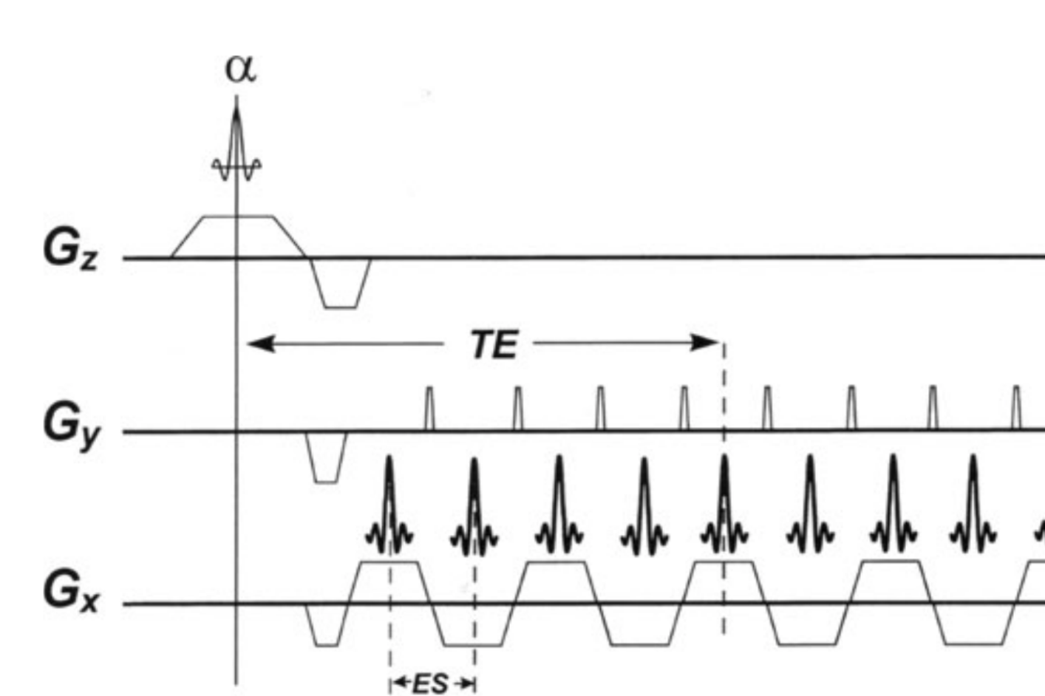
Slice Selective Excitation
Every pulse sequence you have seen so far has a RF pulse along with a gradient waveform
BME639, Dr. Nan-kuei Chen

Slide 10
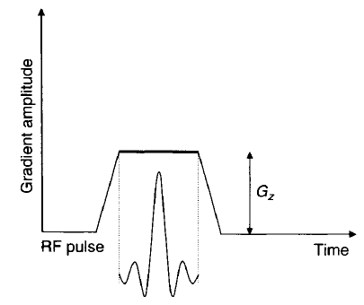
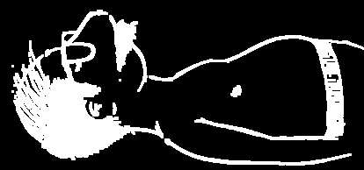
Slice Selective Excitation
By applying a slice selection gradient along with the RF pulse we can localize excitation to a specific slice or region.
Handbook of MRI Pulse Sequences, Bernstein
Slides from Dr. Nan-kuei Chen
Notes:
- The RF pulse and the slice select gradient strength determine the location and thickness of the slice

Slide 11
Slice Selective Excitation
Slice select gradient varies Larmor frequency along slice direction $B\left(z\right)=B_{0}+G_{z}z$
https://www.radiologycafe.com/radiology-trainees/frcr-physics-notes/
Notes:
- The RF pulse and the slice select gradient strength determine the location and thickness of the slice

Slide 12
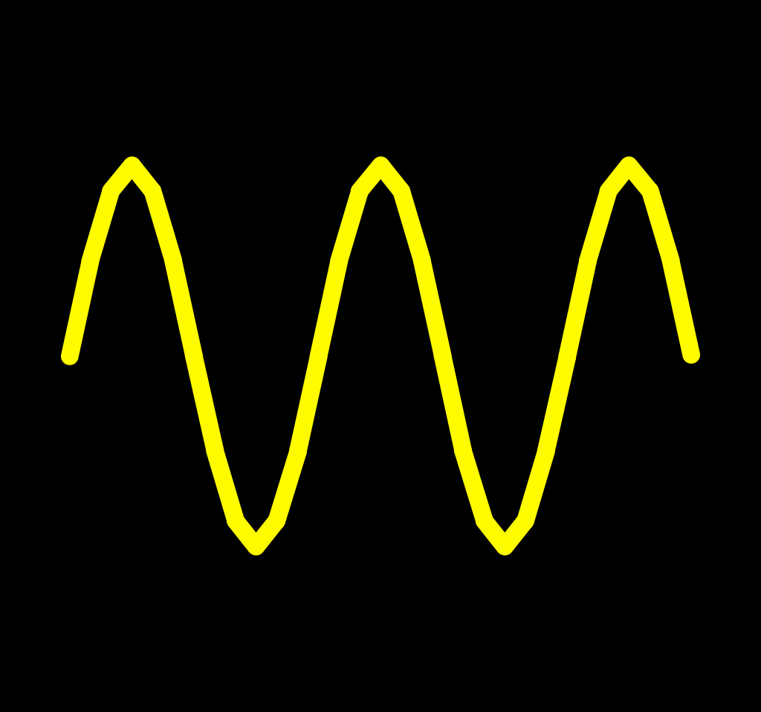
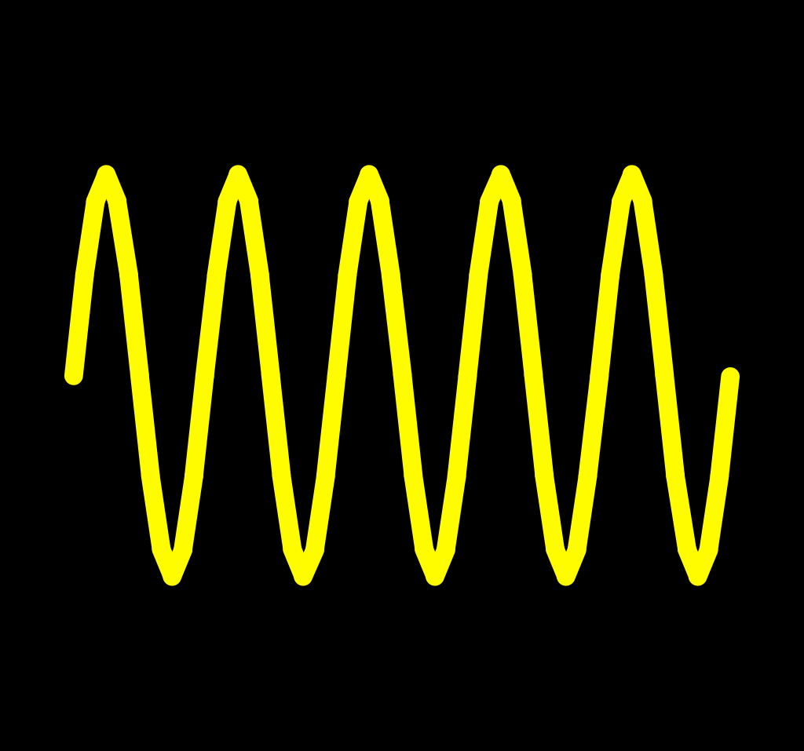
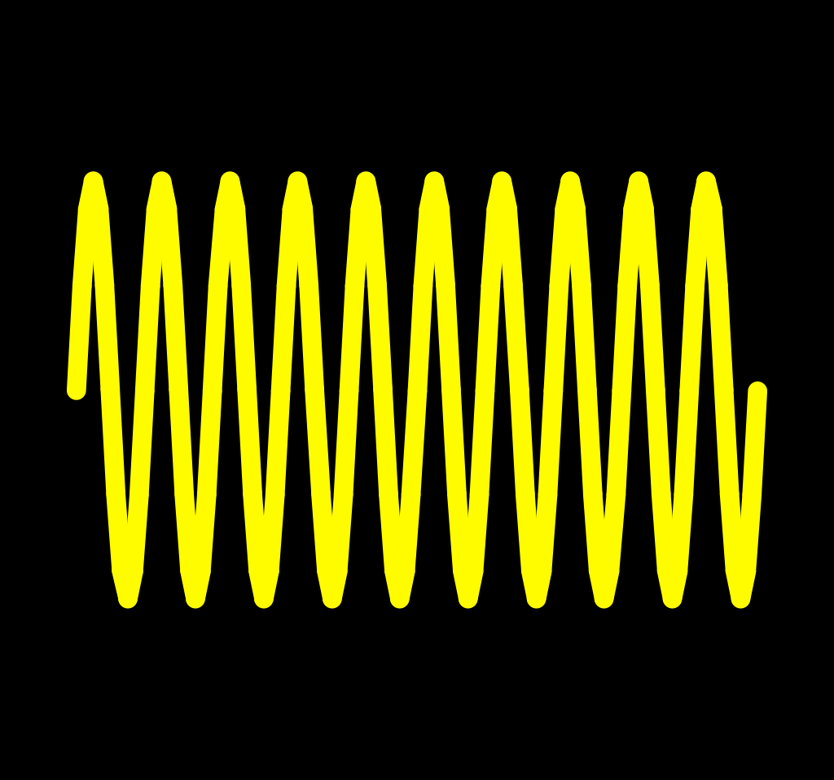
Slice Selective Excitation
Slice select gradient varies Larmor frequency along slice direction $B\left(z\right)=B_{0}+G_{z}z$
Bo
Slides from Dr. Nan-kuei Chen
Notes:
- The RF pulse and the slice select gradient strength determine the location and thickness of the slice

Slide 13
Slice Selective Excitation
This allows RF pulse to selectively excite spins by choosing center frequency
Bo
RF
Slides from Dr. Nan-kuei Chen
Notes:
- The RF pulse and the slice select gradient strength determine the location and thickness of the slice

Slide 14
Slice Selective Excitation
This allows RF pulse to selectively excite spins by choosing center frequency
Bo
RF
Slides from Dr. Nan-kuei Chen
Notes:
- The RF pulse and the slice select gradient strength determine the location and thickness of the slice

Slide 15
Slice Selective Excitation
This allows RF pulse to selectively excite spins by choosing center frequency
https://www.radiologycafe.com/radiology-trainees/frcr-physics-notes/
Notes:
- The RF pulse and the slice select gradient strength determine the location and thickness of the slice

Slide 16
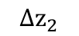
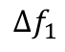
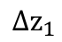
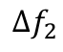

Slice Selective Excitation
Thickness of the excited slice
$$Δf :RF Bandwidth$$
frequency
G_{z}
$$Δf_{2}$$
$$Δf_{1}$$
$$Δz_{1}$$
$$Δz_{2}$$

Slide 17
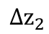
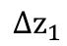
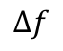
Slice Selective Excitation
Thickness of the excited slice
$$Δf :RF Bandwidth$$
frequency
G_{z1}
In practice, the RF bandwidth is fixed and gradient strength varied
G_{z2}
$$Δf$$
$$Δz_{1}$$
$$Δz_{2}$$

Slide 18
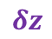
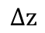
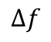
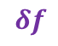
Slice Selective Excitation
Changing the slice location by changing the RF center frequency
$$δf$$
$$Δf$$
$$δz$$
$$Δz$$
Adapted from MRI from Picture to Proton. Cambridge: Cambridge University Press

Slide 19

Quick Summary
High frequency carrier wave modulated by low frequency RF pulse to generate B1 field
Flip angle $θ$ : controls tip angle of magnetization
RF pulse and slice select gradient enable localization of excitation
Slice thickness controlled by RF Bandwidth $Δf$ and gradient amplitude

Slide 20
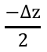
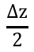
Effect of RF Pulse on Magnetization
A selective RF Pulse excites spins in the slice of interest
Ideally we would like the magnetization from all spins in the selected slice to be tipped at the same flip angle
Ideal slice profile
Flip angle
$$\frac{−Δz}{2}$$
$$\frac{Δz}{2}$$
$$z$$
Slice position
Slice profile ←→ flip angle distribution across slice
Notes:
- Want uniform flip angle within passband of RF

Slide 21
Effect of RF Pulse on Magnetization
Can we measure the flip angle distribution across the slice ?
How does the RF pulse affect magnetization in the slice of interest ?
Notes:
- Want uniform flip angle within passband of RF

Slide 22

Effect of RF Pulse on Magnetization
Bloch Equations: To model effect of B1 field on magnetization
Assuming no T1, T2 relaxation and RF pulse applied in $x$ direction :
$$\frac{d\vec{M}}{dt}=ℛ \vec{M} and ℛ= \left[\begin{matrix}0 & Δω & 0 \\ −Δω & 0 & γB1 \\ 0 & −γB1 & 0\end{matrix}\right] ;$$
$$Δω=γB_{0}−ω_{rf};$$
$\vec{M}=\left[M_{x},M_{y},M_{z}\right] and M_{xy}=M_{x}+iM_{y}$
Notes:
- Want uniform flip angle within passband of RF

Slide 23
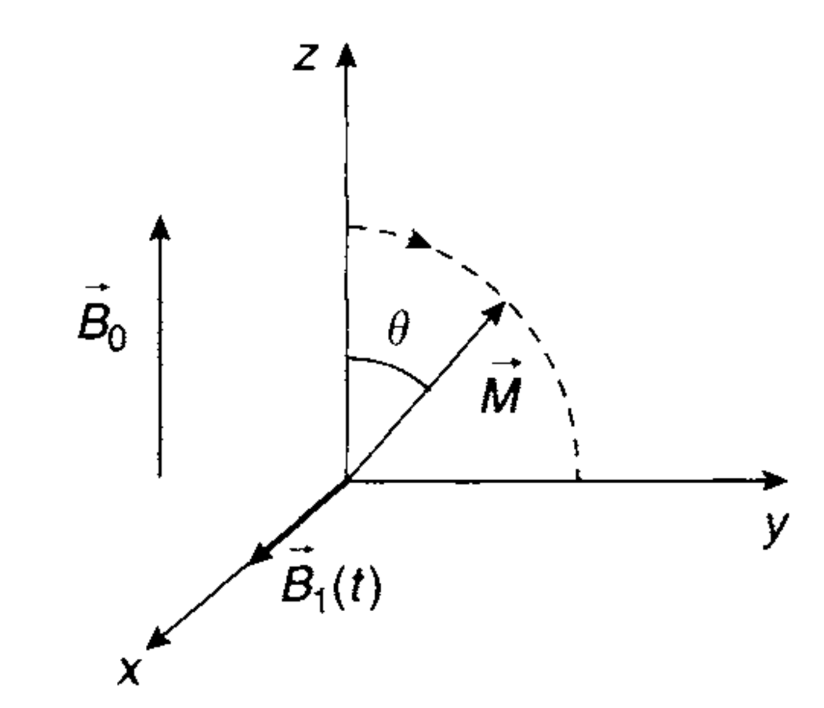

Effect of RF Pulse on Magnetization
Can be solved assuming RF frequency is the Larmor frequency ($Δω=0$) :
$$M_{x}=0$$
$$M_{y}=M_{0} sinθ$$
$$M_{z}=M_{0} cosθ$$
Where flip angle $θ=γ\int_{t^{′}=0}^{T}{B1\left(t^{′}\right)dt′}$
Transverse magnetization $M_{xy}=M_{x}+iM_{y}=iM_{0}sinθ$
Handbook of MRI Pulse Sequences, Bernstein
Notes:
- Want uniform flip angle within passband of RF

Slide 24


Effect of RF Pulse on Magnetization
Since spins are on resonance only at center of the slice, $Δω≠0$
The transverse magnetization can be modeled by
$$\frac{dM_{xy}}{dt}=−iΔωM_{xy}+iγB1\left(t\right)M_{z}(t)$$
Results in the following solution
$$M_{xy}\left(t\right)=iγe^{−i Δωt}\int_{t^{′}=0}^{t}{M_{z}\left(t′\right)B1\left(t′\right)e^{iΔωt^{′}}dt′}$$
Inverse Fourier Transform of $M_{z}\left(t′\right)B1\left(t′\right)$
Notes:
- Want uniform flip angle within passband of RF

Slide 25


Effect of RF Pulse on Magnetization
If the flip angle is small $M_{z}\left(t\right)=M_{0}$ and
$$M_{xy}\left(t\right)=iM_{0}γe^{−i Δωt}\int_{t^{′}=0}^{t}{B1\left(t′\right)e^{iΔωt^{′}}dt′}$$
It can be shown that, $sinθ=\frac{±\left|M_{xy}\right|}{M_{0}}$
and for small angle $θ;$the flip angle distribution is
$$≈ ±γ\left|\int_{t^{′}=0}^{t}{B1\left(t′\right)e^{iΔωt^{′}}dt′}\right|$$
Inverse Fourier Transform of $B1\left(t′\right)$
Notes:
- Want uniform flip angle within passband of RF

Slide 26
RF Pulse Slice Profile
Slice profile ←→ flip angle distribution across slice
Small tip angle approximation:
Slice profile is approximately equal to inverse Fourier transform of RF pulse
Fourier Transform
https://www.chem.purdue.edu/courses/chm621/text/ft/basiset/rect/rect.htm

Slide 27
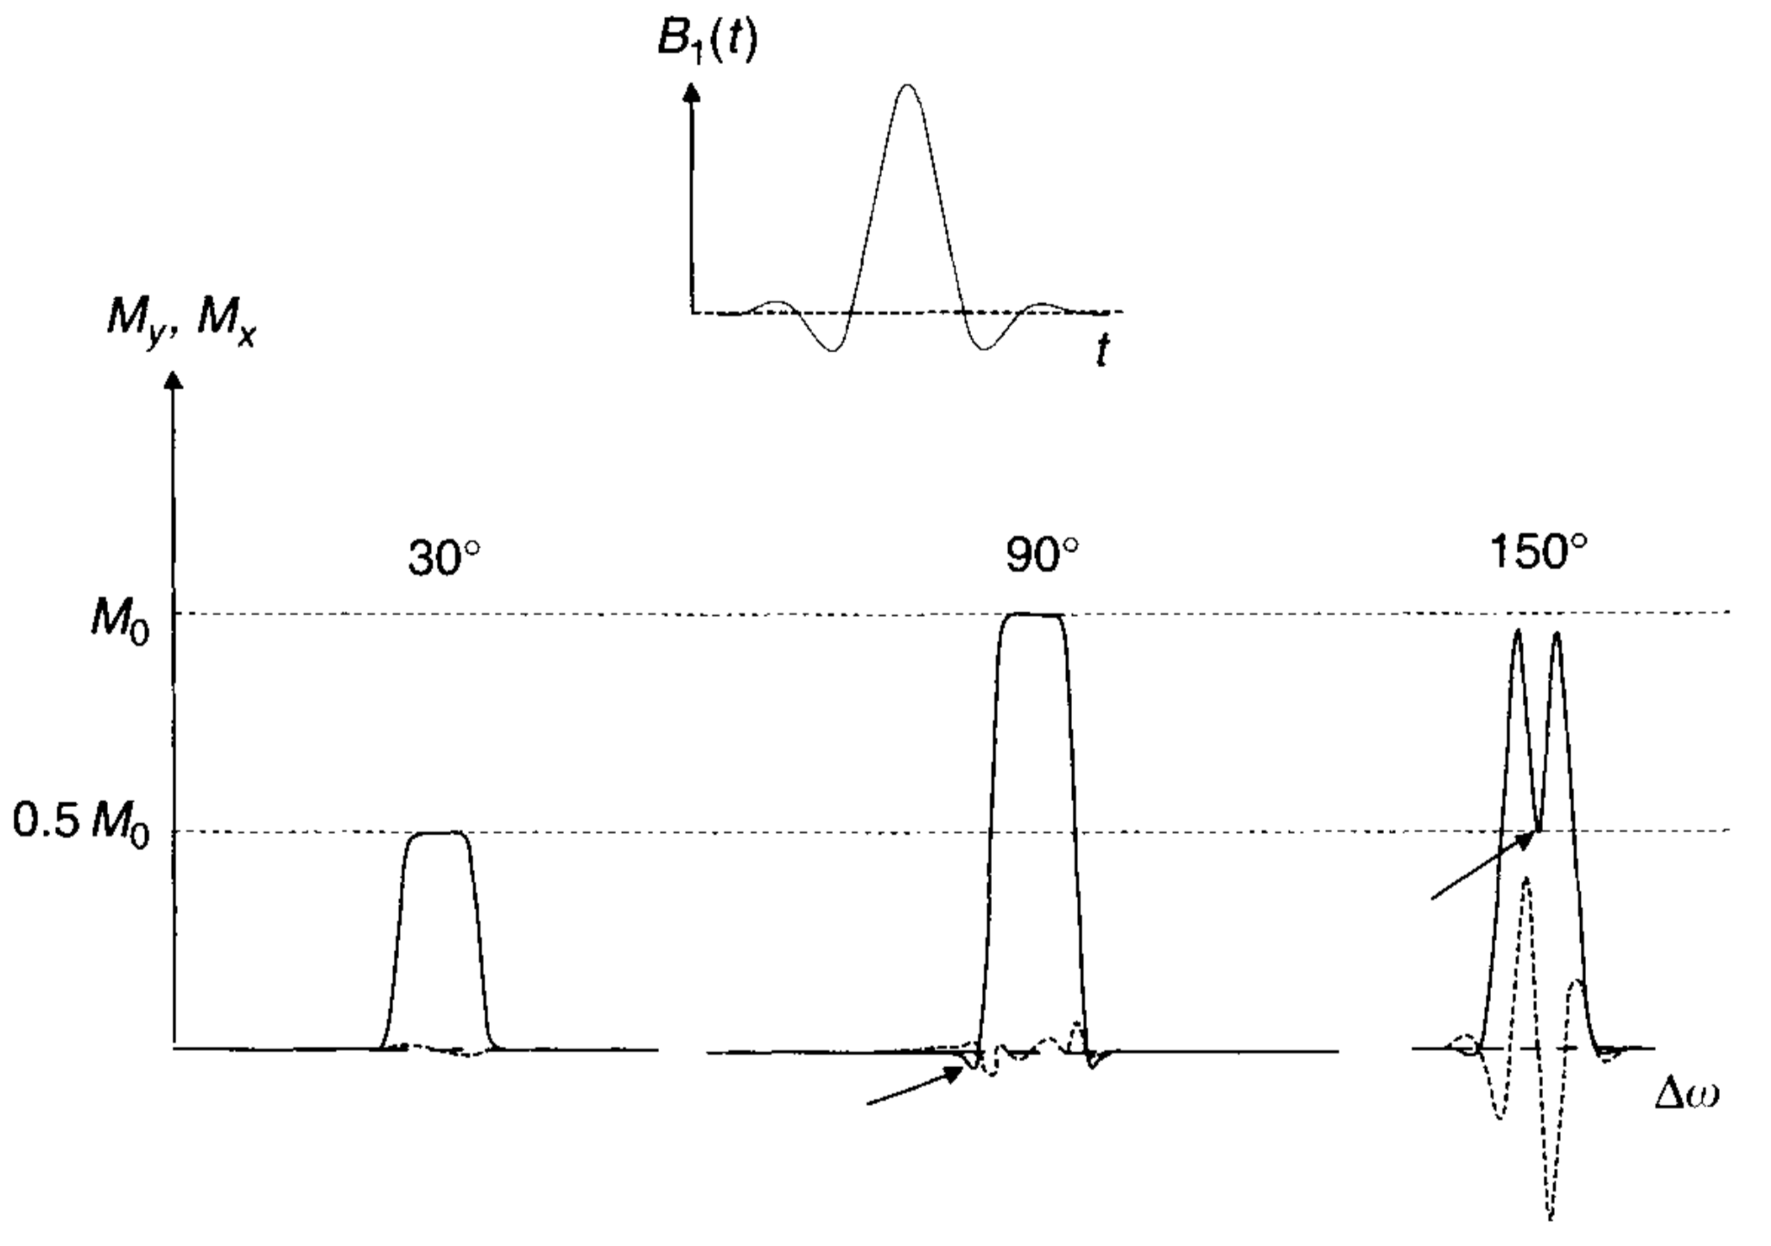

RF Pulse Slice Profile
Slice profile ←→ flip angle distribution across slice
Small tip angle approximation:
Slice profile is approximately equal to inverse Fourier transform of RF pulse
Valid for $θ<{30}^{o}$, breaks down for $θ>{90}^{o}$
Handbook of MRI Pulse Sequences, Bernstein

Slide 28
RF Pulse Slice Profile
Slice profile ←→ flip angle distribution across slice
Small tip angle approximation:
Slice profile is approximately equal to inverse Fourier transform of RF pulse
Valid for $θ<{30}^{o}$, breaks down for $θ>{90}^{o}$
Calculate the slice profile by solving the Bloch equations !
Handbook of MRI Pulse Sequences, Bernstein

